Slide 1


Getting more out of Sanger sequencing
Community DNA fingerprinting
Etienne Low-Decarie
Corey Chivers

Slide 2
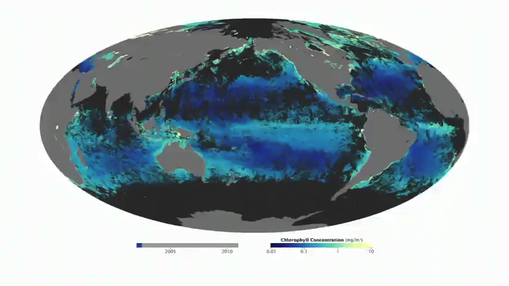

Microbial community composition
(phyto)plankton
soil decomposers
images: NHGRI and NASA

Slide 3
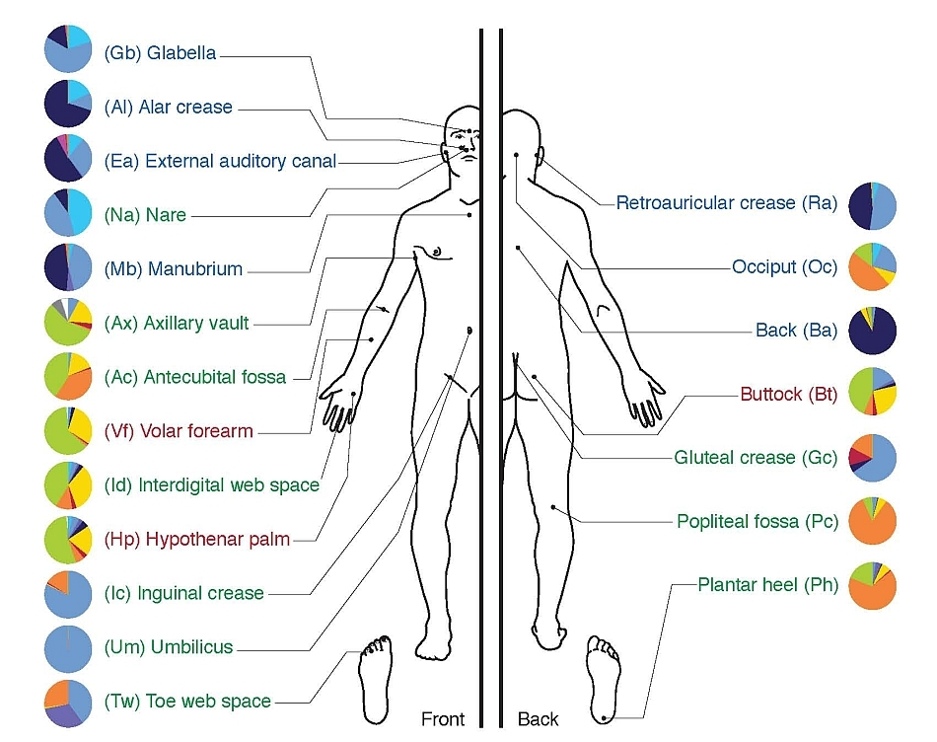
Microbial community composition
Human microbiome
images: NHGRI

Slide 4
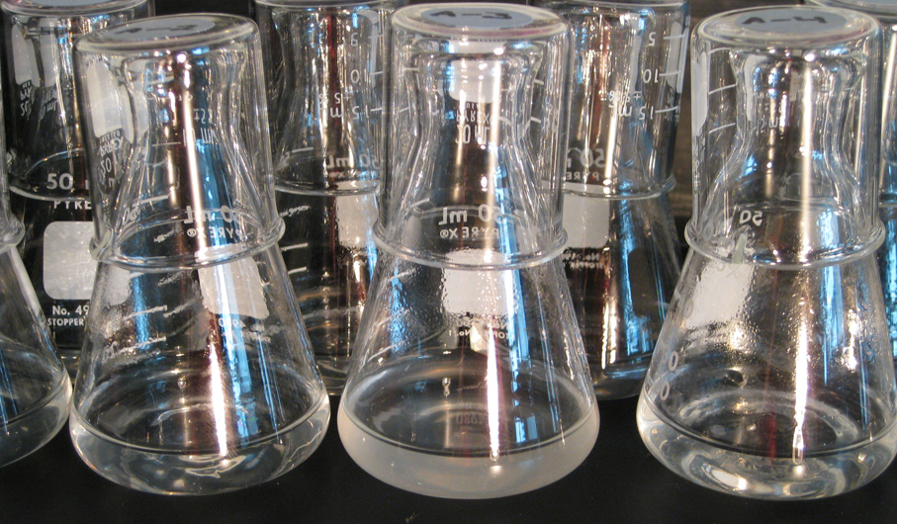
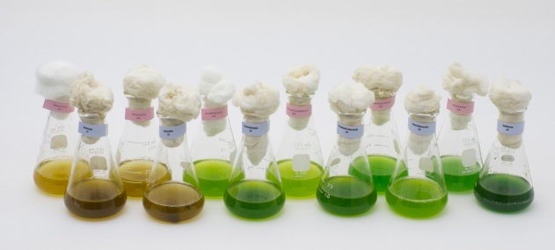
Microbial community composition
Experimental ecology and evolution
left image: Richard E. Lenski

Slide 5
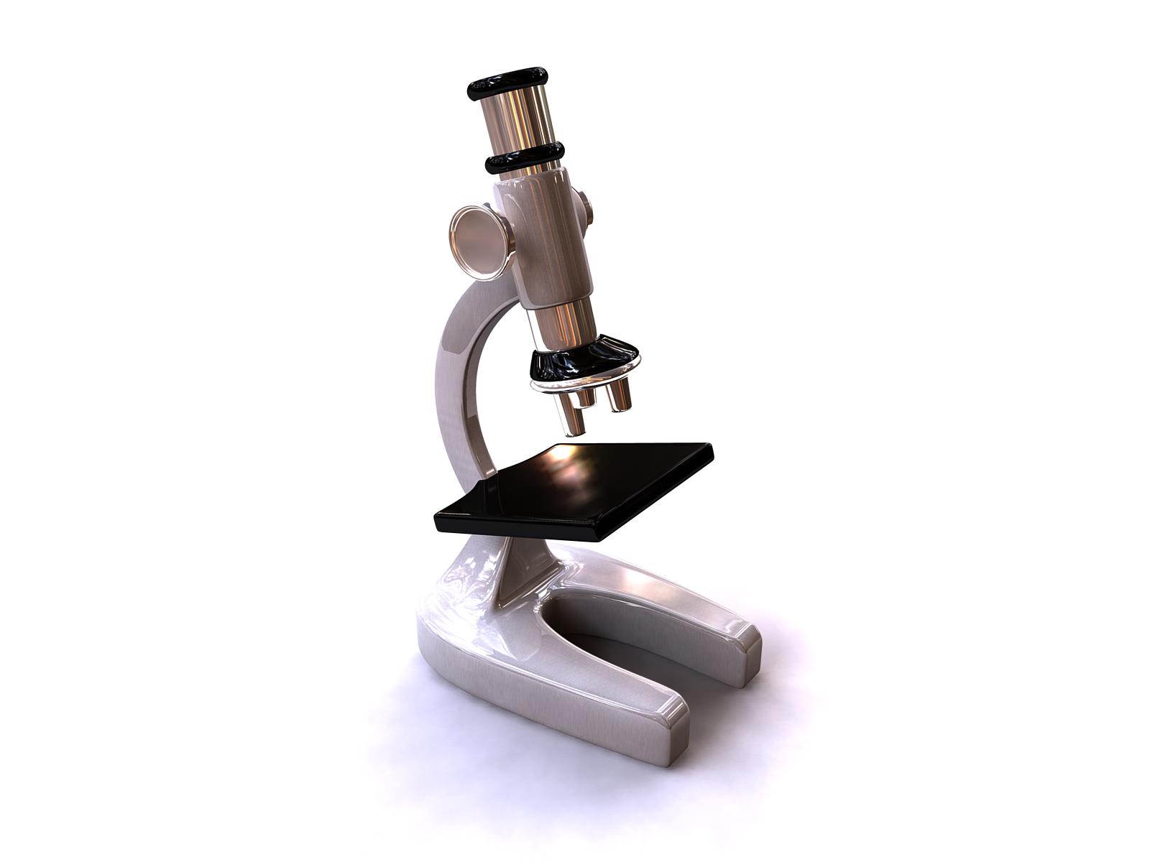
Limits of traditional taxonomy
Few microbes can be cultured
Many are not visually distinguishable
When at all possible
requires expertise
tedious
often unfeasible
…

Slide 6
Community fingerprint
Community level characteristic resulting from the proportional sum of characteristics of its constituent species
synonyms: profile
fingerprinting: using this characteristic to determine community composition
3x
2x
½ x

Slide 7
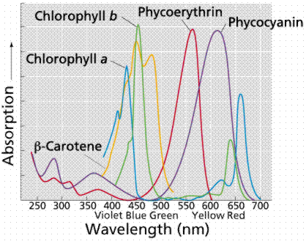
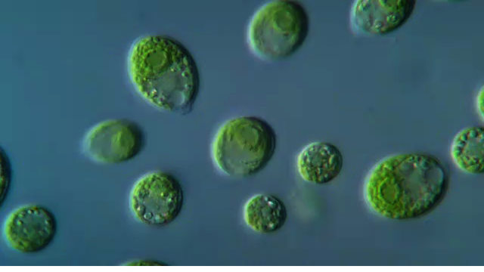
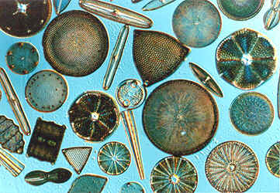
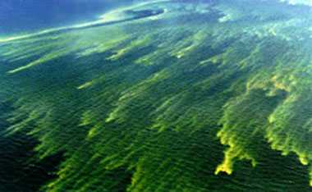
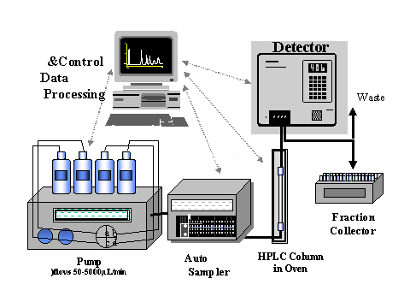

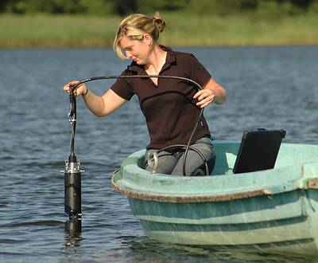

Pigment fingerprinting
images: Academy of Natural Sciences, BBE moldaenke and others

Slide 8
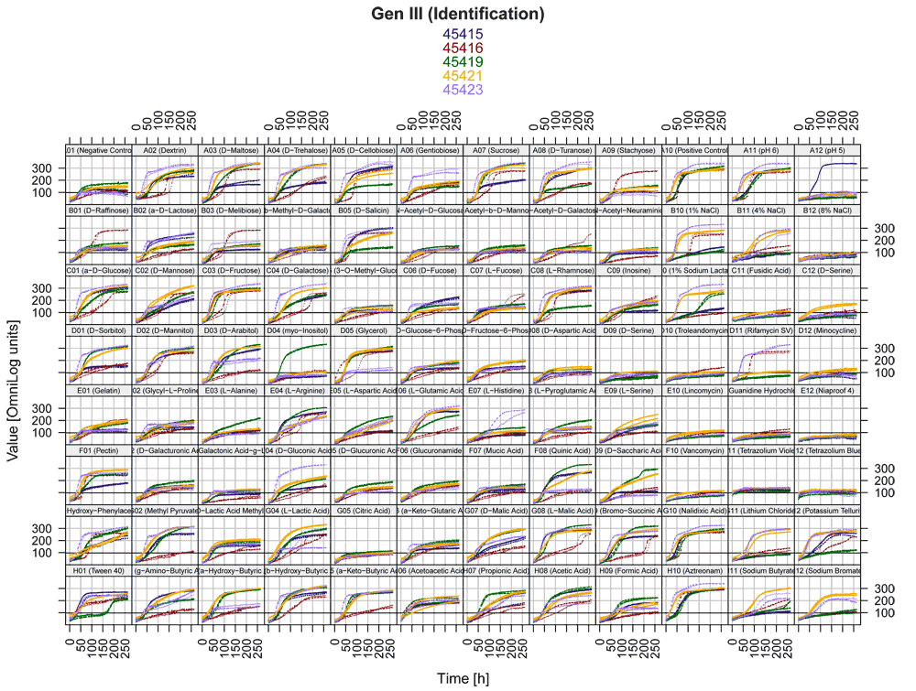

Physiological fingerprint
Sole carbon source utilization fingerprint
BIOLOG eco-plates
Toxicological finger print
Target specific antibiotic
Toxin and metals

Slide 9
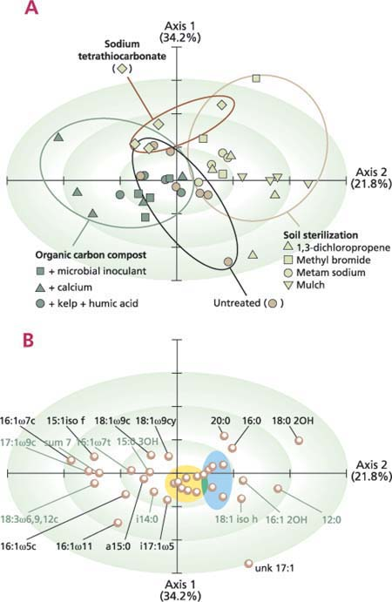
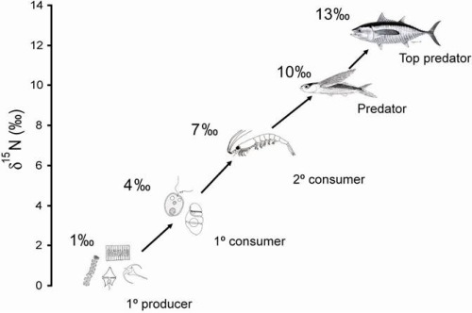
Chemical fingerprinting
Fatty acid fingerprinting
Fatty acid methyl ester (FAME)
Phospholipid fatty acid (PLFA)
Isotope fingerprinting
Trophic structure signal
images:Rebecca E. Drenovsky, Roger A. Duncan, Kate M. Scow,SPC ocean fisheries programme,

Slide 10
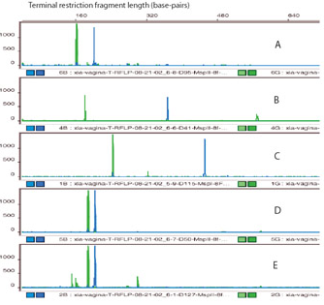
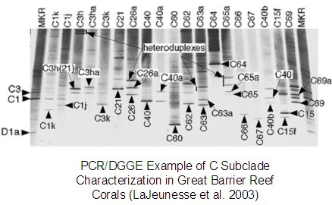
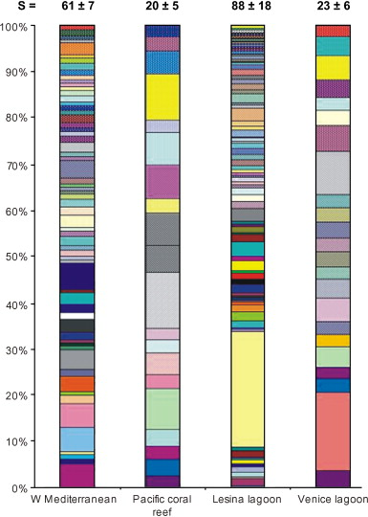
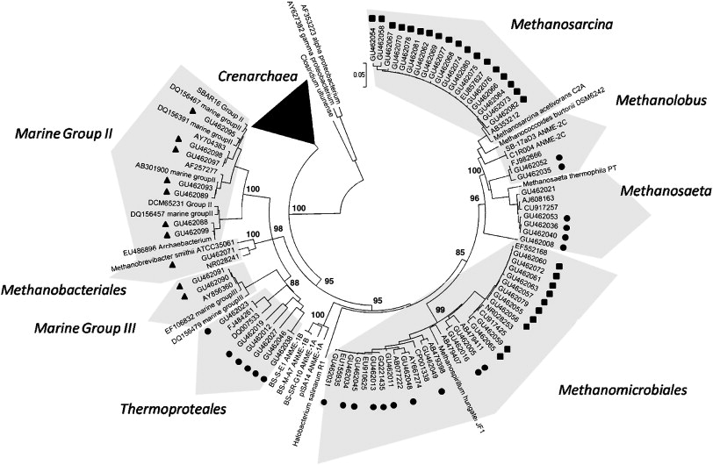
DNA fingerprints (metagenomics)
Terminal Restriction Fragment Length Polymorphism (T-RFLP)
Denaturing Gradient Gel Electrophoresis (DGGE)
Ribosomal Intergenic Spacer Analysis (RISA)
…
Cloning and (Sanger) sequencing
High-throughput sequencing
Reviews:
Nocker et al. 2007
images: Xia Zhou, Gregory W. Schmidt, Roberto Danovaro and Antonio Pusceddu,
Stephan Gantnera, Anders F. Anderssona, Laura Alonso-Sáeza, Stefan Bertilsson

Slide 11
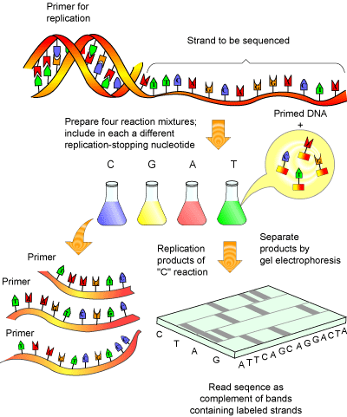
Chain-termination (Sanger) sequencing
NAGTCGTCCA
images: Helmut Kae

Slide 12
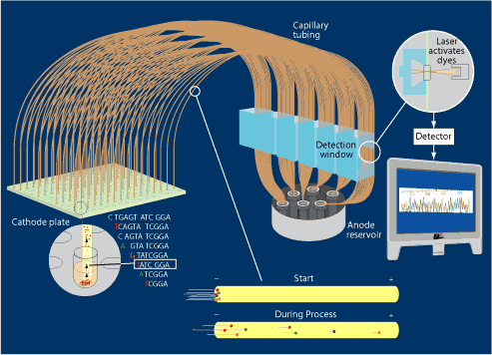
Chain-termination (Sanger) sequencing
images: Steven M. Carr

Slide 13
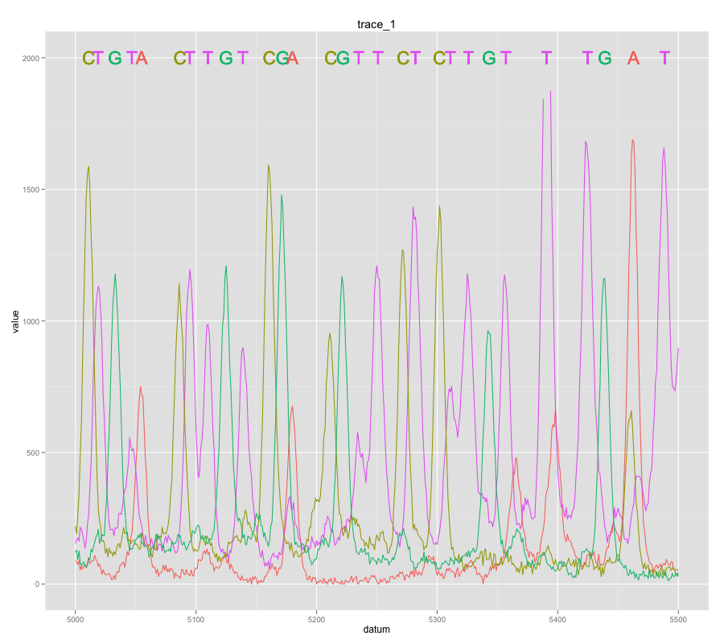
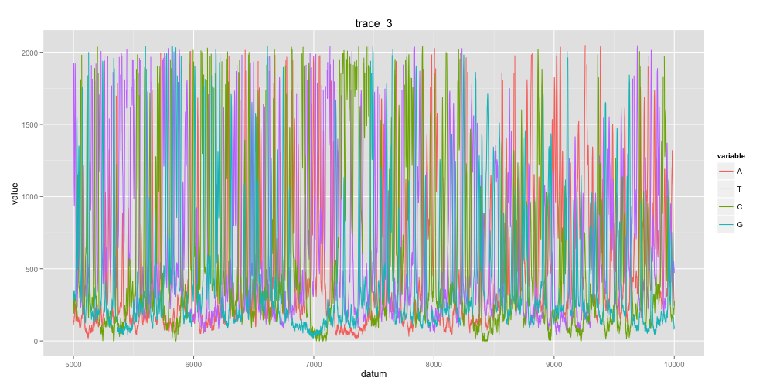
Chain-termination (Sanger) sequencing
images: Steven M. Carr

Slide 14
Heterozygote trace

Slide 15
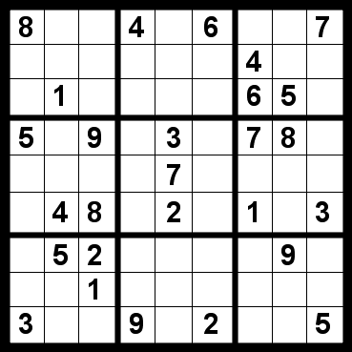

Our naïve logical leap
If it has not been done, maximum likelihood is centered around two possibilities:
Can’t be done
Shouldn’t be done

Slide 16
Two type community trace
type: any taxonomic level with common primers and distinguishing loci
genotype, species, genus…

Slide 17
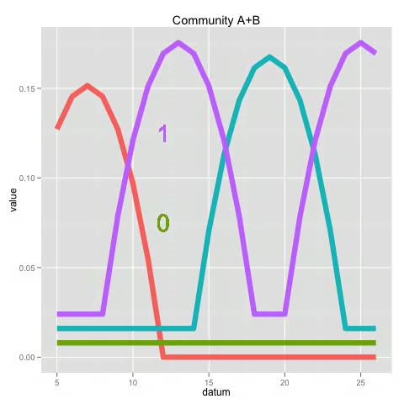
Two species community trace

Slide 18
Community trace

Slide 19
Simulation

Slide 20
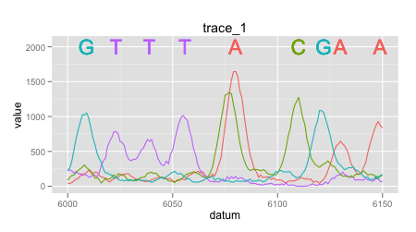
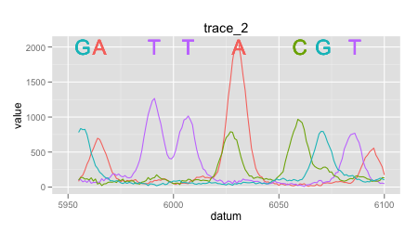
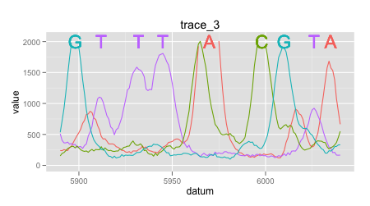
Two type trace

Slide 21
Quantification of visually aligned traces
Sum of square optimization
Trace improvement
Ratio
Remove effect of total signal amplitude
Threshold
Remove effect of low signal/high noise regions
(Community - (quantity • Type 1 + quantity • Type 2))²

Slide 22
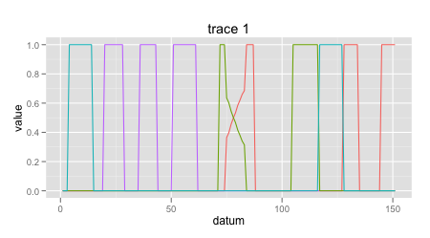
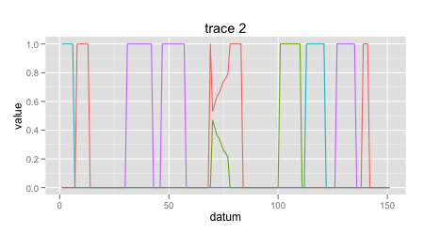
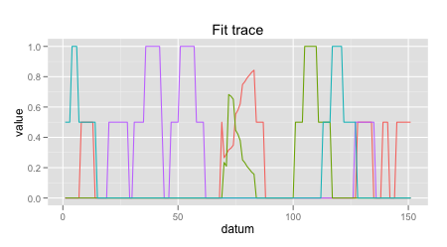
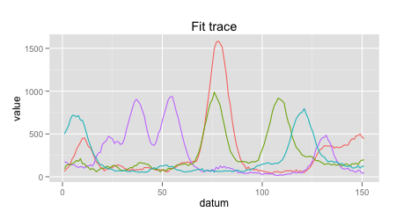
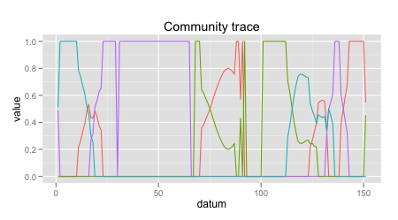
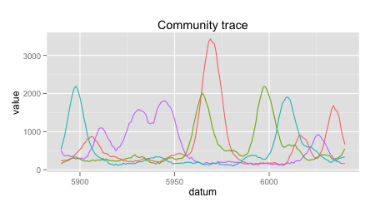
Quantification of visually aligned traces
0.658
0.439
≈

Slide 23
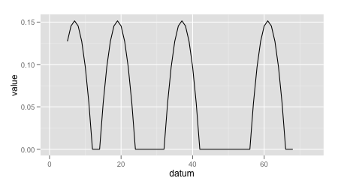
Trace segmentation and alignment
Traces are shifted
Alignment
Segment shift through 0 padding
Grid search
Traces contain drift
Only small segments can be aligned
Segmentation
Provides boostrapping
Optimization
At each step of grid
After grid search

Slide 24
Distribution of quantification with segmentation and alignment

Slide 25
Fingerprinting base ratio
Issues
Base calling and peak detection

Slide 26
Quantification steps
Align
Quantify

Slide 27
Potential advantages
Any taxonomic level/resolution
Species
Major group
Uses existing technology and infrastructure

Slide 28
Next steps
Get your expert opinion/feedback
…
Dilution series
Multiple species

Slide 29
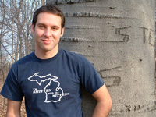
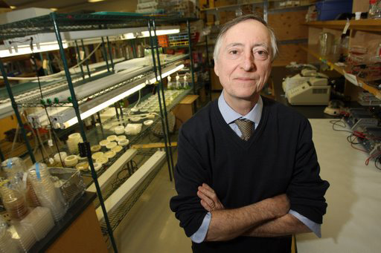
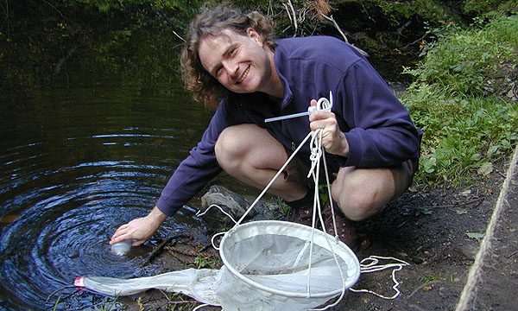
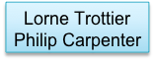




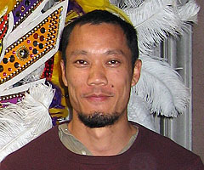




Acknowledgements
Adam Herman
BELL LAB
FUSSMANN LAB
LEUNG LAB
Contacts and code
https://github.com/edielivon/community-DNA-fingerprinting
etienne.webhop.org etienne.low-decarie@mail.mcgill.ca

